Slide 1
DIGITAL
COMPUTER
ORGANIZATION
->Jaspreet Singh Khurana

Slide 2
INDEX
Introduction To Computer.
Input-Output Organization.
Memory Organization
CPU-Organization.
Control Unit.

Slide 3
INTRODUCTION TO COMPUTER

Slide 4
Computer Organization and Architecture
In order to achieve complete understandings of computer systems, it is always important to consider both hardware and software design of various computer components. In other words, every functionality of the computer has to be studied to increase the performance of the computer.
Computer organization and architecture mainly focuses on various parts of the computer in order to reduce the execution time of the program, improve the performance of each part. Generally, we tend to think computer organization and computer architecture as same but there is slight difference.

Slide 5
DIFFERENCE:
Computer Organization is study of the system from software point of view and gives overall description of the system and working principles without going into much detail. In other words, it is mainly about the programmer’s or user point of view.
Computer Architecture is study of the system from hardware point of view and emphasis on how the system is implemented. Basically, throws light on the designer’s point of view.

Slide 6
Von Neumann Architecture
Whatever we do to enhance performance, we cannot get away from the fact that instructions can only be done one at a time and can only be carried out sequentially. Both of these factors hold back the competence of the CPU. This is commonly referred to as the ‘Von Neumann bottleneck’. We can provide a Von Neumann processor with more cache, more RAM, or faster components but if original gains are to be made in CPU performance then an influential inspection needs to take place of CPU configuration . This architecture is very important and is used in our PCs and even in Super Computers. It is also known as IAS computer and is having three basic units:
The Central Processing Unit (CPU)
The Main Memory Unit
The Input/Output Device

Slide 7
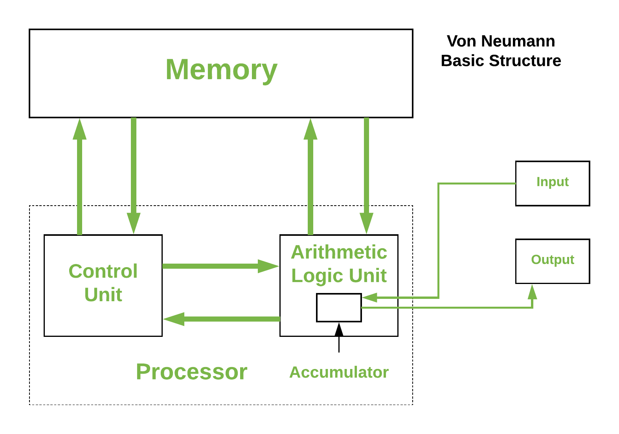

Slide 8
Computer Components
Computers internal architectural design comes in different types and sizes, but the basic structure remains same of all computer systems. The term 'computer hardware' or 'computer parts' is used to describe computer components that can be seen and touched. The major components of general-purpose computer system are Input Unit, main/internal Memory or Storage Unit, Output Unit, Central Processing unit. The CPU is further includes Arithmetic logic unit (ALU) and control unit (CU). All the units also referred to as "The functional units”. Devices that are not integral part of CPU referred to as peripherals.
.

Slide 9
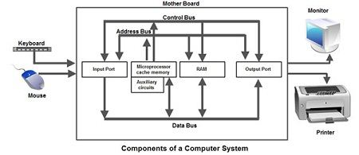

Slide 10
Interconnection Structures
A computer consists of a set of components or modules of three basic types (processor, memory, I/O) that communicate with each other. In effect, a computer is a network of basic modules. Thus, there must be paths for connecting the modules. The collection of paths connecting the various modules is called the interconnection structure. The design of this structure will depend on the exchanges that must be made among modules.
Figure below suggests the types of exchanges that are needed by indicating the major forms of input and output for each module type.

Slide 11
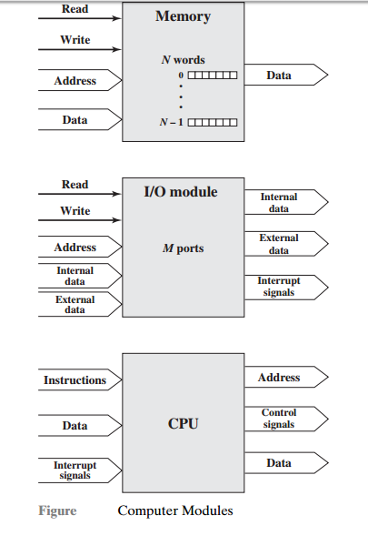

Slide 12
Memory: Typically, a memory module will consist of N words of equal length. Each word is assigned a unique numerical address (0, 1, . . . , N – 1). A word of data can be read from or written into the memory.The nature of the operation is indicated by read and write control signals. The location for the operation is specified by an address.
I/O module: From an internal (to the computer system) point of view, I/O is functionally similar to memory. There are two operations, read and write. Further, an I/O module may control more than one external device. We can refer to each of the interfaces to an external device as a port and give each a unique address (e.g., 0, 1,…, M – 1). In addition, there are external data paths for the input and output of data with an external device. Finally, an I/O module may be able to send interrupt signals to the processor.

Slide 13
Processor: The processor reads in instructions and data, writes out data after processing, and uses control signals to control the overall operation of the system. It also receives interrupt signals. The preceding list defines the data to be exchanged. The interconnection structure must support the following types of transfers:
• Memory to processor: The processor reads an instruction or a unit of data from memory.
• Processor to memory: The processor writes a unit of data to memory.
• I/O to processor : The processor reads data from an I/O device via an I/O module.
• Processor to I/O: The processor sends data to the I/O device.
• I/O to or from memory: For these two cases, an I/O module is allowed to exchange data directly with memory, without going through the processor, using direct memory access (DMA).

Slide 14
Bus Interconnection
A bus is a communication pathway connecting two or more devices.
It is a shared transmission medium.
A bus consists of multiple pathways or lines.
A bus that connects major components (CPU ,Memory ,I/O) is called System Bus.

Slide 15
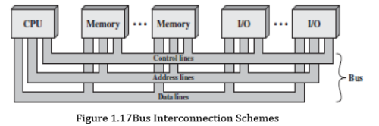

Slide 16
Each line is assigned a particular meaning or function . The lines can be classified into 3 functional groups
1. Data line
2.Address line
3.Control line
DATA LINE
Provide a path for moving data between system modules . These lines, collectively, are called the data bus. Data bus may consist of from 32 to 100 separated line . Each line can carry only one bit at a time . Number of line in the bus determine the data rate and overall the system performance.

Slide 17
ADDRESS LINE
Used to designate the source or destination of the data on the data bus. The width of the address bus determines the maximum possible memory capacity of the system.
Control line
Used to control the access to and the use of the data and address lines.
Since the data and the address line shared by all the components, there must be a means of controlling their use.
Control signal transmit both commands and timing information between the modules.
Typical control lines include
Memory write, Memory read ,I/O write , I/O read , Clock , Reset, Bus request, Bus grant, Interrupt request, Interrupt ACK ,Transfer ACK

Slide 18
INPUT – OUTPUT
ORGANIZATION

Slide 19
The input-output subsystem of a computer provides an efficient mode of communication between the central system and the outside environment. It handles all the input-output operations of the computer system.
PERIPHERALS:- Input or output devices that are connected to computer are called peripheral devices. These devices are designed to read information into or out of the memory unit upon command from the CPU and are considered to be the part of computer system. These devices are also called peripherals

Slide 20
There are three type of Peripheral-
Input Peripherals- An input device is a peripheral(piece of computer hardware equipment) used to provide data and control signals to an information processing system such as a computer or other information appliance.
Output Peripherals-An output device is any peripheral that receives data from a computer, usually for display, projection, or physical reproduction.
Input-output Peripherals-The I/O (input and output) peripheral are used primarily for communication between the computer and the external environment. They provide the ability to enter commands to the PC, and vice versa, i.e. send commands to outside to perform some task on a given device.

Slide 21
Working Of Peripherals
An input device converts incoming data and instructions into a pattern of electrical signals in binary code that are comprehensible to a digital computer. An output device reverses the process, translating the digitized signals into a form intelligible to the user.
Input peripherals : Allows user input, from the outside world to the computer. Example: Keyboard, Mouse etc.
Output peripherals: Allows information output, from the computer to the outside world. Example: Printer, Monitor etc.
Input-Output peripherals: Allows both input(from outside world to computer) as well as, output(from computer to the outside world). Example: Touch screen etc.

Slide 22
Interrupt Driven I/O
Interrupt driven I/O is an alternative scheme dealing with I/O. Interrupt I/O is a way of controlling input/output activity whereby a peripheral or terminal that needs to make or receive a data transfer sends a signal. This will cause a program interrupt to be set. At a time appropriate to the priority level of the I/O interrupt. Relative to the total interrupt system, the processors enter an interrupt service routine. The function of the routine will depend upon the system of interrupt levels and priorities that is implemented in the processor. The interrupt technique requires more complex hardware and software, but makes far more efficient use of the computer’s time and capacities. Figure 2 shows the simple interrupt processing.

Slide 23
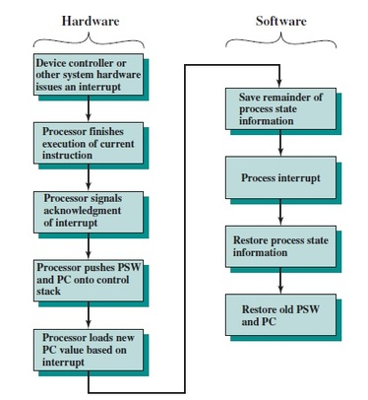

Slide 24
Priority Interrupt
Priority Interrupt are systems, that establishes a Priority over the various sources(interrupt devices) to determine which condition is to be serviced first when two or more requests arrive simultaneously . This system may also determine which condition are permitted to interrupt to the computer while another interrupt is being serviced . Usually, in Priority Systems, higher-priority interrupt levels are served first, as if they delayed or interrupted, could have serious consequences . And the devices with high-speed transfer such as magnetic disks are given high-priority, and slow devices such as keyboards receives low-priority.

Slide 25
Direct Memory Access
DMA stands for "Direct Memory Access" and is a method of transferring data from the computer's RAM to another part of the computer without processing it using the CPU. While most data that is input or output from your computer is processed by the CPU, some data does not require processing, or can be processed by another device. n these situations, DMA can save processing time and is a more efficient way to move data from the computer's memory to other devices. In order for devices to use direct memory access, they must be assigned to a DMA channel. Each type of port on a computer has a set of DMA channels that can be assigned to each connected device. For example, a PCI controller and a hard drive controller each have their own set of DMA channels.

Slide 26
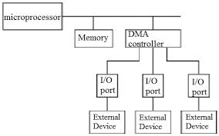

Slide 27
I/O Processor
An input-output processor (IOP) is a processor with direct memory access capability. In this, the computer system is divided into a memory unit and number of processors.
Each IOP controls and manage the input-output tasks. The IOP is similar to CPU except that it handles only the details of I/O processing. The IOP can fetch and execute its own instructions. These IOP instructions are designed to manage I/O transfers only.

Slide 28
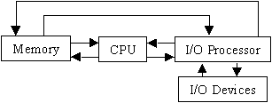

Slide 29
Synchronous Data Transfer
In Synchronous data transfer, the sending and receiving units are enabled with same clock signal. It is possible between two units when each of them knows the behavior of the other. The master performs a sequence of instructions for data transfer in a predefined order. All these actions are synchronized with the common clock. The master is designed to supply the data at a time when the slave is definitely ready for it. Usually, the master will introduce sufficient delay to take into account the slow response of the slave, without any request from the slave.

Slide 30
Asynchronous Data Transfer
In most computer asynchronous mode of data transfer is used in which two component have a different clock. Data transfer can occur between data in two ways serial and parallel. In case of parallel multiple lines are used to send a single bit whereas in serial transfer each bit is send one at a time. To tell other devices when the character/data will be given a concept of start and end bit is used. A start bit is denoted by 0 and stop bit is detected when line return to 1-state at least one time, here 1-state means that there is not data transfer is occurring.

Slide 31
Strobe Control
In computer or memory technology, a strobe is a signal that is sent that validates data or other signals on adjacent parallel lines. In memory technology, the CAS (column address strobe) and RAS ( row address strobe ) signals are used to tell a dynamic RAM that an address is a column or row address.

Slide 32
Strobe Mechanism
Source initiated Strobe – When source initiates the process of data transfer. Strobe is just a signal. Step are-
(i) First, source puts data on the data bus and ON the strobe signal.
(ii) Destination on seeing the ON signal of strobe, read data from the data bus.
(iii) After reading data from the data bus by destination, strobe gets OFF

Slide 33
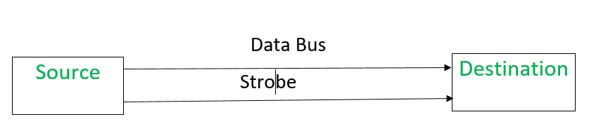
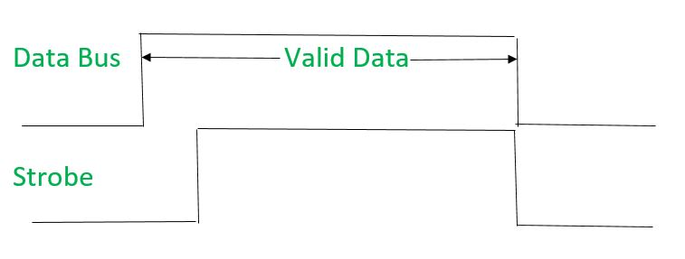

Slide 34
Destination initiated signal – When destination initiates the process of data transfer.Steps are-
(i) First, the destination ON the strobe signal to ensure the source to put the fresh data on the data bus.
(ii) Source on seeing the ON signal puts fresh data on the data bus.
(iii) Destination reads the data from the data bus and strobe gets OFF signal.

Slide 35
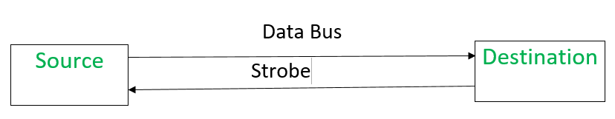
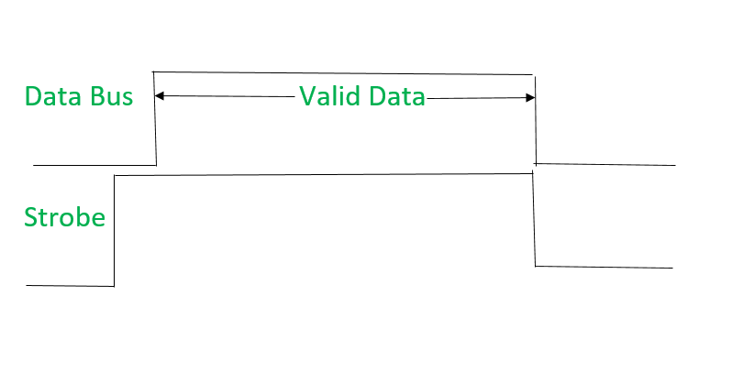

Slide 36
Working principle of keyboard
Working Principle of a Keyboard:-Inside the keyboard, there are metallic plate, circuit board and processor, which are responsible for transferring information from the keyboard to the computer. Depending upon the working principle, there are two main types of keys, namely, capacitive and hard-contact. Let's discuss in brief about the functioning of capacitive and hard contact key . When a capacitive key is pressed, the metal plunger applies a gentle pressure to the circuit board. The pressure is identified by the computer and the circuit flow is initiated, resulting in the transfer of information from the circuit to the currently installed software.
The key identifying to computer is identified using a keyboard driver and finding the preferred key called
source code.

Slide 37
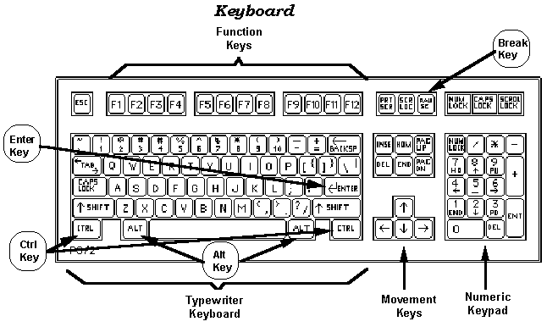

Slide 38
Working Mechanism Of Mouse
The main goal of any mouse is to translate the motion of your hand into signals that the computer can use. Let's take a look inside a track-ball mouse to see how it works:
A ball inside the mouse touches the desktop and rolls when the mouse moves. The underside of the mouse's logic board: The exposed portion of the ball touches the desktop.

Slide 39
Two rollers inside the mouse touch the ball. One of the rollers is oriented so that it detects motion in the X direction, and the other is oriented 90 degrees to the first roller so it detects motion in the Y direction. When the ball rotates, one or both of these rollers rotate as well. The following image shows the two white rollers on this mouse: The rollers that touch the ball and detect X and Y motion.
The rollers each connect to a shaft, and the shaft spins a disk with holes in it. When a roller rolls, its shaft and disk spin.

Slide 40
On either side of the disk there is an infrared LED and an infrared sensor. The holes in the disk break the beam of light coming from the LED so that the infrared sensor sees pulses of light. The rate of the pulsing is directly related to the speed of the mouse and the distance it travels. A close-up of one of the optical encoders that track mouse motion: There is an infrared LED (clear) on one side of the disk and an infrared sensor (red) on the other.
An on-board processor chip reads the pulses from the infrared sensors and turns them into binary data that the computer can understand. The chip sends the binary data to the computer through the mouse's cord.

Slide 41
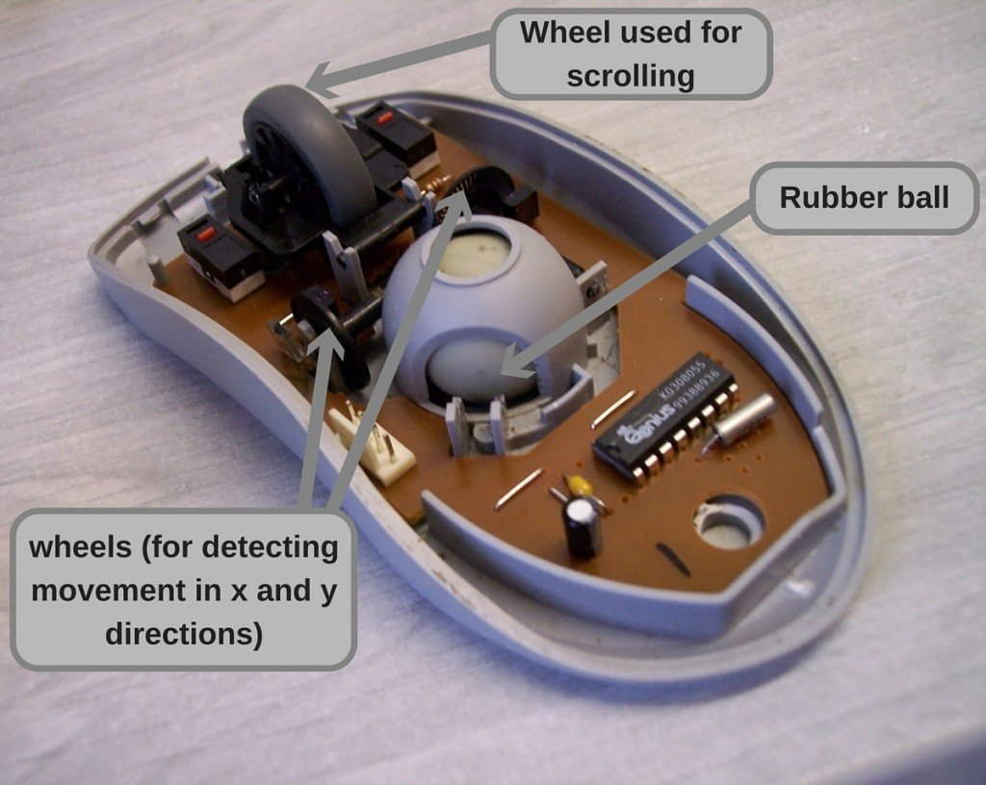

Slide 42
Working Mechanism Of Scanner
Scanners operate by shining light at the object or document being digitized and directing the reflected light (usually through a series of mirrors and lenses) onto a photosensitive element. In most scanners, the sensing medium is an electronic, light-sensing integrated circuit known as a charged coupled device (CCD). Light-sensitive photosites arrayed along the CCD convert levels of brightness into electronic signals that are then processed into a digital image.

Slide 43
CCD is by far the most common light-sensing technology used in modern scanners. Two other technologies, CIS (Contact Image Sensor), and PMT (photomultiplier tube) are found in the low and high ends of the scanner market, respectively. CIS is a newer technology that allows scanners to be smaller and lighter, but sacrifices dynamic range, depth-of-field, and resolution. PMT-based drum scanners produce very high-quality images.
Another sensing technology, CMOS (Complementary Metal Oxide Semiconductor), appears primarily in low-end, hand-held digital cameras where its low cost, low power consumption and easier component integration permits smaller, less expensive designs. Traditionally, high-end and professional digital cameras employ CCD sensors, despite their expense and the complexity of their design, because they exhibit much superior noise characteristics. Although some innovative designs that render low-noise CMOS-based images are emerging, CCD still dominates the high end of the market.

Slide 44
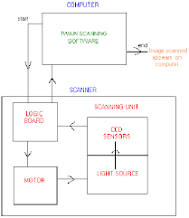

Slide 45
Touch Screen Panel
Touch screen technology is the direct manipulation type gesture based technology. Direct manipulation is the ability to manipulate digital world inside a screen. A Touch screen is an electronic visual display capable of detecting and locating a touch over its display area. This is generally refers to touching the display of the device with a finger or hand. This technology most widely used in computers, user interactive machines, smart phones, tablets etc to replace most functions of the mouse and keyboard.

Slide 46
Types of Touch Screen Technology
The Touch screen is a 2-dimensional sensing device made of 2 sheets of material separated by spacers. There are four main touch screen technologies:
Resistive.
Capacitive .
Surface Acoustical wave (SAW).
Infrared (IR).

Slide 47
Resistive
Resistive touch screen is composed of a flexible top layer made of polythene and a rigid bottom layer made of glass separated by insulating dots, attached to a touch screen controller. Resistive touch screen panels are more affordable but offering only 75% of light monitor and the layer can be damaged by sharp objects. Resistive touch screen is further divided into 4-, 5-, 6-, 7-, 8- wired resistive touch screen. The construction design of all these modules is similar but there is a major distinction in each of its method to determine the coordinates of touch.

Slide 48
Capacitive
A capacitive touch screen panel is coated with a material that stores electrical charges. The capacitive systems can transmit up to 90% of light from the monitor. It is divided into two categories. In Surface-capacitive technology only one side of the insulator is coated with a conducting layer. Whenever a human finger touches the screen, conduction of electric charges occurs over the uncoated layer which results in the formation of dynamic capacitor. The controller then detects the position of touch by measuring the change in capacitance at the four corners of the screen.

Slide 49
Surface Acoustic wave
The surface acoustic wave technology
contains two transducers placed along X axis and Y-axis of the monitor’s glass plate along with some reflectors. When the screen is touched, the waves are absorbed and a touch is detected at that point. These reflectors reflect all electrical signals sent from one transducer to another. This technology provides excellent through put and quality.

Slide 50
Infrared
In infrared touch screen technology, an array of X and Y axis is fitted with pairs of IR Leds and photo detectors. Photo detectors will detect any image in the pattern of light emitted by the Leds whenever the user touches the screen.

Slide 51
Working mechanism of touch screen panel
A basic touch screen is having a touch sensor, a controller, and a software driver as three main components. The touch screen is needed to be combined with a display and a PC to make a touch screen system.
Touch sensor:The sensor generally has an electrical current or signal going through it and touching the screen causes a change in the signal. This change is used to determine the location of the touch of the screen.

Slide 52
Controller:A controller will be connected between touch sensor and PC. It takes information from sensor and translates it for understanding of PC. The controller determines what type of connection is needed.
Software driver : It allows computer and touch screen to work together. It tells OS how to interact the touch event information that is sent from the controller.

Slide 53
MEMORY
ORGANIZATION

Slide 54
MEMORY HIERARCHY
The memory hierarchy design in a computer system mainly includes different storage devices. Most of the computers were inbuilt with extra storage to run more powerfully beyond the main memory capacity. The following memory hierarchy diagram is a hierarchical pyramid for computer memory. The designing of the memory hierarchy is divided into two types such as primary (Internal) memory and secondary (External) memory.

Slide 55
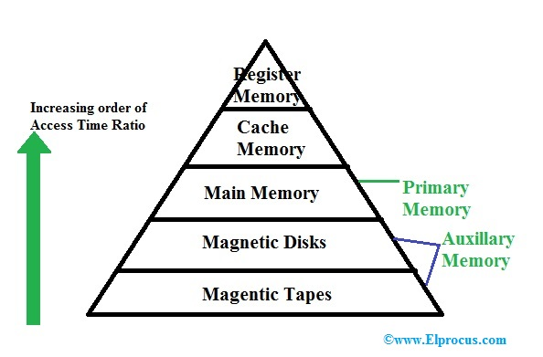

Slide 56
INTERNAL MEMORY
Internal memory (also known as main memory or prime memory), often referred to simply as memory, is the only one directly accessible to the CPU. The CPU continuously reads instructions stored there and executes them as required. Any data actively operated on is also stored there in uniform manner.
It typically refers to main memory (RAM), but may also refer to ROM and flash memory. In either case, internal memory generally refers to chips rather than disks or tapes.

Slide 57
EXTERNAL MEMORY
Secondary storage (also known as external memory or auxiliary storage), differs from primary storage in that it is not directly accessible by the CPU. The computer usually uses its input/output channels to access secondary storage and transfer the desired data to primary storage. Secondary storage is non-volatile (retaining data when power is shut off). Modern computer systems typically have two orders of magnitude more secondary storage than primary storage because secondary storage is less expensive.
It typically refers to portable flash drive, hard drive or a memory card that is used in a device such as a camera.

Slide 58
TYPES OF PRIMARY MEMORY
ROM (Read only memory)
PROM
EPROM
EEPR OM
RAM (Random access memory)
SRAM
DRAM

Slide 59
ROM
Read-only memory, or ROM, is a type of computer storage containing non-volatile, permanent data that, normally, can only be read, not written to. ROM contains the programming that allows a computer to start up or regenerate each time it is turned on. ROM also performs large input/output (I/O) tasks and protects programs or software instructions. Once data is written on a ROM chip, it cannot be removed.It has 3 types –
PROM
EPROM
EEPROM

Slide 60
PROM
It stands for programmable read-only memory, a memory chip on which data can be written only once. Once a program has been written onto a PROM, it remains there forever. Unlike RAM, PROMs retain their contents when the computer is turned off.
The difference between a PROM and a ROM (read-only memory) is that a PROM is manufactured as blank memory, whereas a ROM is programmed during the manufacturing process. To write data onto a PROM chip, you need a special device called a PROM programmer or PROM burner. The process of programming a PROM is sometimes called burning the PROM.

Slide 61
EPROM
EPROM (erasable programmable read-only memory) is programmable read-only memory (programmable ROM) that can be erased and re-used. Erasure is caused by shining an intense ultraviolet light through a window that is designed into the memory chip. (Although ordinary room lighting does not contain enough ultraviolet light to cause erasure, bright sunlight can cause erasure).

Slide 62
EEPROM
EEPROM (electrically erasable programmable read-only memory) is user-modifiable read-only memory (ROM) that can be erased and reprogrammed (written to) repeatedly through the application of higher than normal electrical voltage. Unlike EPROM chips, EEPROMs do not need to be removed from the computer to be modified. However, an EEPROM chip has to be erased and reprogrammed in its entirety, not selectively. It also has a limited life - that is, the number of times it can be reprogrammed is limited to tens or hundreds of thousands of times. In an EEPROM that is frequently reprogrammed while the computer is in use, the life of the EEPROM can be an important design consideration.

Slide 63
RAM
RAM (Random Access Memory) is the hardware in a computing device where the operating system (OS), application programs and data in current use are kept so they can be quickly reached by the device's processor. RAM is the main memory in a computer, and it is much faster to read from and write to than other kinds of storage, such as a hard disk drive (HDD), solid-state drive (SSD) or optical drive.

Slide 64
DRAM
Stands for "Dynamic Random Access Memory." DRAM is a type of RAM that stores each bit of data on a separate capacitor. This is an efficient way to store data in memory, because it requires less physical space to store the same amount of data than if it was stored statically. Therefore, a DRAM chip can hold more data than an SRAM (static RAM) chip of the same size can. However, the capacitors in DRAM need to constantly be refreshed to keep their charge, so DRAM requires more power than SRAM.

Slide 65
SRAM
SRAM (static RAM) is random access memory (RAM) that retains data bits in its memory as long as power is being supplied. Unlike dynamic RAM (DRAM), which stores bits in cells consisting of a capacitor and a transistor, SRAM does not have to be periodically refreshed. Static RAM provides faster access to data and is more expensive than DRAM. SRAM is used for a computer's cache memory and as part of the random access memory digital-to-analog converter on a video card.

Slide 66
CACHE MEMORY ORGANIZATION
Cache Memory is a special very high-speed memory. It is used to speed up and synchronizing with high-speed CPU. Cache memory is costlier than main memory or disk memory but economical than CPU registers. Cache memory is an extremely fast memory type that acts as a buffer between RAM and the CPU. It holds frequently requested data and instructions so that they are immediately available to the CPU when needed.

Slide 67
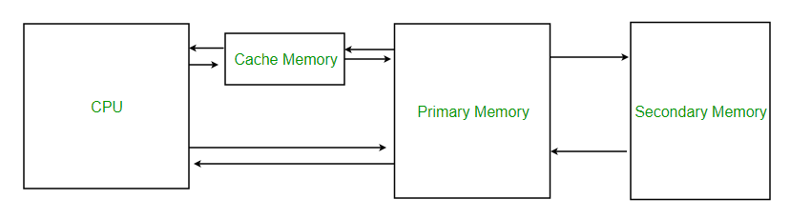

Slide 68
VIRTUAL MEMORY
Virtual Memory is a storage allocation scheme in which secondary memory can be addressed as though it were part of main memory. The addresses a program may use to reference memory are distinguished from the addresses the memory system uses to identify physical storage sites, and program generated addresses are translated automatically to the corresponding machine addresses.The size of virtual storage is limited by the addressing scheme of the computer system and amount of secondary memory is available not by the actual number of the main storage locations.

Slide 69
TYPES OF SECONDARY STORAGE
MAGNETIC DISKS.
MAGNETIC TAPES.
OPTICAL MEMORY.
DVD.

Slide 70
MAGNETIC DISKS
A magnetic disk is a storage device that uses a magnetization process to write, rewrite and access data. A magnetic disk primarily consists of a rotating magnetic surface and a mechanical arm that moves over it. The mechanical arm is used to read from and write to the disk. The data on a magnetic disk is read and written using a magnetization process. Data is organized on the disk in the form of tracks and sectors, where tracks are the circular divisions of the disk. Tracks are further divided into sectors that contain blocks of data. All read and write operations on the magnetic disk are performed on the sectors.

Slide 71
MAGNETIC TAPES
A magnetic tape drive is a storage device that makes use of magnetic tape as a medium for storage.It uses a long strip of narrow plastic film with tapes of thin magnetizable coating.Magnetic tape drives store data on magnetic tape using digital recording.The tapes are usually stored on cartridges or cassettes, but for drives that are used as data storage tape backups, the tape is often wound on reels. Magnetic tape is not the most dense data storage medium.

Slide 72
OPTICAL MEMORY
Optical storage is the storage of data on an optically readable medium. Data is recorded by making marks in a pattern that can be read back with the aid of light, usually a beam of laser light precisely focused on a spinning optical disc. An older example of optical storage that does not require the use of computers, is microform. There are other means of optically storing data and new methods are in development. An optical disc drive is a device in a computer that can read CD-ROMs or other optical discs, such as DVDs and Blue-ray discs. Optical storage differs from other data storage techniques that make use of other technologies such as magnetism, such as floppy disks and hard disks, or semiconductors, such as flash memory and RAM.

Slide 73
DVD
Stands for "Digital Versatile Disc." A DVD is a type of optical media used for storing digital data. It is the same size as a CD, but has a larger storage capacity. Some DVDs are formatted specifically for video playback, while others may contain different types of data, such as software programs and computer files. The original "DVD-Video" format was standardized in 1995 by consortium of electronics companies, including Sony, Panasonic, Toshiba, and Philips.

Slide 74
CPU ORGANIZATION

Slide 75
General Register Organization
When we are using multiple general purpose registers, instead of single accumulator register, in the CPU Organization then this type of organization is known as General register based CPU Organization. In this type of organization, computer uses two or three address fields in their instruction format. Each address field may specify a general register or a memory word. If many CPU registers are available for heavily used variables and intermediate results, we can avoid memory references much of the time, thus vastly increasing program execution speed, and reducing program size.

Slide 76
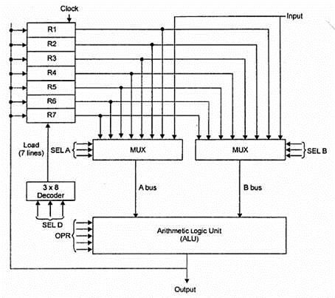

Slide 77
Stack Organization
The computers which use Stack-based CPU Organization are based on a data structure called stack. The stack is a list of data words. It uses Last In First Out (LIFO) access method which is the most popular access method in most of the CPU. A register is used to store the address of the topmost element of the stack which is known as Stack pointer (SP). In this organization, ALU operations are performed on stack data. It means both the operands are always required on the stack. After manipulation, the result is placed in the stack.

Slide 78
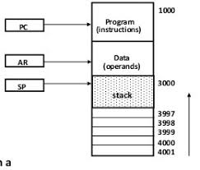

Slide 79
Accumulator Type Organization
The computers, present in the early days of computer history, had accumulator based CPUs. In this type of CPU organization, the accumulator register is used implicitly for processing all instructions of a program and store the results into the accumulator. The instruction format that is used by this CPU Organization is One address field. Due to this the CPU is known as One Address Machine.

Slide 80
The main points about Single Accumulator based CPU Organization are:
In this CPU Organization, the first ALU operand is always stored into the Accumulator and the second operand is present either in Registers or in the Memory.
Accumulator is the default address thus after data manipulation the results are stored into the accumulator.
One address instruction is used in this type of organization.

Slide 81
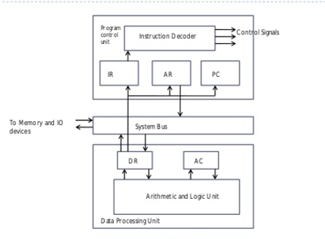

Slide 82
INSTRUCTION FORMATS
Three Address Instruction.
Two Address Instruction.
One Address Instruction.
Instruction Set Selection.

Slide 83
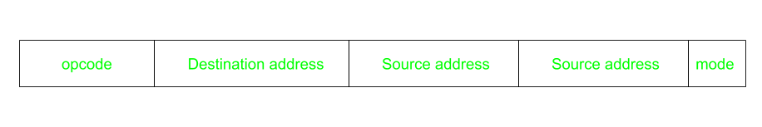
Three Address Instruction.
This has three address field to specify a register or a memory location. Program created are much short in size but number of bits per instruction increase. These instructions make creation of program much easier but it does not mean that program will run much faster because now instruction only contain more information but each micro operation (changing content of register, loading address in address bus etc.) will be performed in one cycle only.

Slide 84
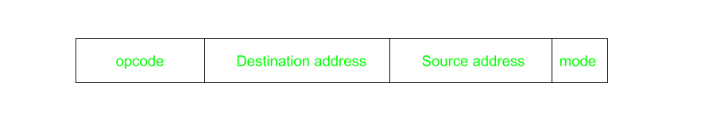
Two Address Instruction
This is common in commercial computers. Here two address can be specified in the instruction.Unlike earlier in one address instruction the result was stored in accumulator here result cab be stored at different location rather than just accumulator, but require more number of bit to represent address.

Slide 85

One Address Instruction
This use a implied ACCUMULATOR register for data manipulation.One operand is in accumulator and other is in register or memory location.Implied means that the CPU already know that one operand is in accumulator so there is no need to specify it.

Slide 86
Instruction Set Selection
The instruction set, also called ISA (instruction set architecture), is part of a computer that pertains to programming, which is basically machine language. The instruction set provides commands to the processor, to tell it what it needs to do. The instruction set consists of addressing modes, instructions, native data types, registers, memory architecture, interrupt, and exception handling, and external I/O.

Slide 87
ADDRESSING MODES
Immediate.
Direct.
Indirect.
Register.
Indexed.

Slide 88
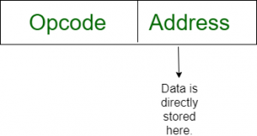
IMMEDIATE
In this mode data is present in address field of instruction .Designed like one address instruction format . Limitation in the immediate mode is that the range of constants are restricted by size of address field.

Slide 89

Direct
The operand’s offset is given in the instruction as an 8 bit or 16 bit displacement element. In this addressing mode the 16 bit effective address of the data is the part of the instruction.
Here only one memory reference operation is required to access the data.

Slide 90
Indirect
This addressing mode utilizes the computer's ability of Segment : Offset addressing .In this mode address field of instruction contains the address of effective address . Here two references are required.
1st reference to get effective address.
2nd reference to access the data. Indirect addressing is generally used for variables containing several elements like, arrays. Starting address of the array is stored in, say, the EBX register.

Slide 91

Register
In this addressing mode, a register contains the operand. In this,the operand is placed in one of 8 bit or 16 bit general purpose registers. The data is in the register that is specified by the instruction. Here one register reference is required to access the data.

Slide 92
Indexed
The address of the operand is obtained by adding to the contents of the general register (called index register) a constant value. The number of the index register and the constant value are included in the instruction code. Index Mode is used to access an array whose elements are in successive memory locations.

Slide 93
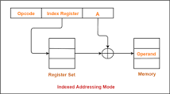

Slide 94
CONTROL UNIT

Slide 95
Instruction Word Format
Instruction format An instruction is normally made up of a combination of an operation code and some way of specifying an operand, most commonly by its location or address in memory though non memory reference instructions can exist. Some operation codes deal with more than one operand; the locations of these operands may be specified using any of the many addressing schemes . Classically, the number of address references has been used to specify something about the architecture of a particular computer. In some instruction formats and machine architectures, the number of operand references may be fixed; in others the number is variable.

Slide 96
Fetch Cycle
The fetch execute cycle is the basic operation (instruction) cycle of a computer (also known as the fetch decode execute cycle).
During the fetch execute cycle, the computer retrieves a program instruction from its memory. It then establishes and carries out the actions that are required for that instruction.
At the beginning of the fetch cycle, the address of the next instruction to be executed is in the Program Counter(PC).

Slide 97
Step 1: The address in the program counter is moved to the memory address register(MAR), as this is the only register which is connected to address lines of the system bus.
Step 2: The address in MAR is placed on the address bus, now the control unit issues a READ command on the control bus, and the result appears on the data bus and is then copied into the memory buffer register(MBR). Program counter is incremented by one, to get ready for the next instruction.(These two action can be performed simultaneously to save time).
Step 3: The content of the MBR is moved to the instruction register(IR).

Slide 98
Execution Cycle
It is the part of the cycle when data processing actually take place and the instruction is called upon data & The result of this processing is stored in another register this is called Execution cycle. The other three cycles(Fetch, Indirect and Interrupt) are simple and predictable. Each of them requires simple, small and fixed sequence of micro-operation. In each case same micro-operation are repeated each time around.
Execute Cycle is different from them. Like, for a machine with N different opcodes there are N different sequence of micro-operations that can occur .

Slide 99
Microprogramming Concepts
Process of writing microcode for a microprocessor. Microcode is low-level code that defines how a microprocessor should function when it executes machine-language instructions. Typically, one machine-language instruction translates into several microcode instructions. On some computers, the microcode is stored in ROM and cannot be modified; on some larger computers, it is stored in EPROM and therefore can be replaced with newer versions.

Slide 100
THANKS

